Slide 1
Chapter Two
Processes and process management
By Abebaw S.

Slide 2
Outline
Process and Thread
The concept of multi-threading
Inter process communication
  Race conditioning
  Critical Sections and mutual exclusion
Process Scheduling
  Preemptive and non preemptive scheduling
  Scheduling policies
Dead lock
  Deadlock prevention
  Deadlock detection
  Deadlock avoidance

Slide 3
Process concept
Process can be defined as
  Unit of work
  It is a program in execution.
  It is an instance of running program
  It is an entity that can be assigned to a processor
A program is a set of instructions to perform a specific task.
For example, when we write a program in C++ and compile it, the compiler creates binary code. The original code and binary code are both programs. When we actually run the binary code, it becomes a process.

Slide 4
Process (continue . . . )
A single program can create many processes. For example, when we open binary file multiple times, multiple processes are created.
Difference between program and process
Program | Process
Def: collection of instructions designed to accomplish a certain task. Nature: passive entity. Lifespan: much higher | Def: an instance of an running program. Nature: active entity. Lifespan: limited.

Slide 5
Process (continue . . . )
Differences (Continue …)
Program | Process
Resource: require only memory space to store the instructions. Computation Time: has no computation time and cost. | Resource: It requires CPU, memory address, disk, Input/output during its lifetime. Computation Time: Takes a long time to access and compute a single fact.

Slide 6
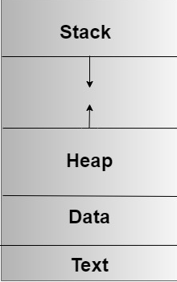
Process (continue . . . )
In main memory, a process has four sections:
  Text: consists of the current activity of a process represented by:
      Value of the Program Counter
      Contents processor’s registers.
  Data: This has global and static variables.
Fig: Process in Memory

Slide 7
Process (continue . . . )
  Stack: Contains temporary data such as function parameters, return address , and local variables.
  Heap: Dynamically memory allocated to process during its run time.

Slide 8
Process State (Continue. . .)
The process, from its creation to completion, passes through various states.
The state of the process defined by the current activity of the process.
Each process may be in one of the following states:
  New: The process is being created; Or a process which is going to be picked up by the OS into the main memory.
  Ready: Processes that are in the main memory and are prepared for execution; but not currently assigned to the processor.

Slide 9

Process State ( Continue. . .)
Fig : Diagram of Process State

Slide 10
Process State ( Continue. . .)
  Running: Instructions are being executed. In this state the process access the CPU.
  Waiting: The process is waiting for some event to occur. Or when the process waits for a certain resource (Example I/O) the OS moves this process to the waiting state and assigns the CPU to the other process.
  Terminated: The process has finished execution.

Slide 11
Process State ( Continue. . .)
Other states
  Suspended ready : A process in the ready state, which is moved to the secondary memory from main memory due to lack of resource.
  Suspended wait : If the process in waiting state, requires a resources; but it lacks resources, then the OS removes that process and put it in the secondary memory.

Slide 12
Process State Transition
A process transitions
  Are change of states of a process due to an event.
  They are represented by arrows in a process state diagram, shows the possible states and transitions of a process.
  For example, a process can transition from ready to running when the scheduler selects it for execution, or from running to waiting when it requests an I/O operation.
  The Fig in the next slide shows the process state transitions

Slide 13
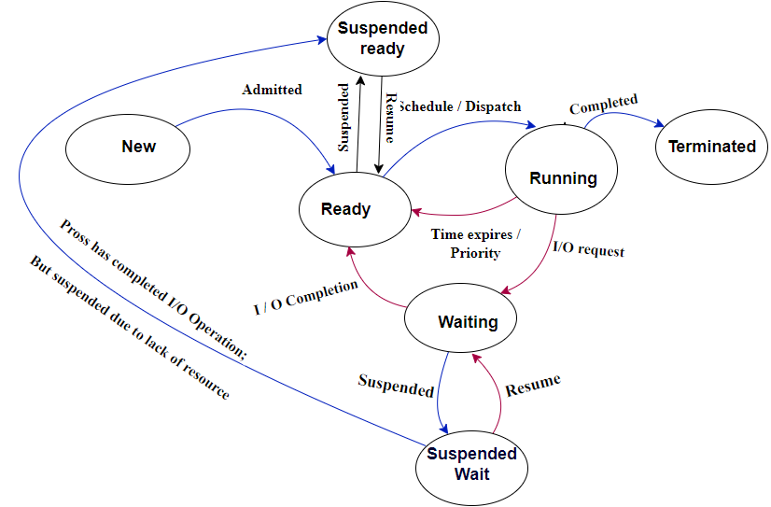
Process State Transition( Continue. . .)
Fig: Process State Transition

Slide 14
Process State Transition
Null to new: A new process is created for the implementation of a process.
New to ready: When the OS has allocated resources to it and it is ready to be executed.
Ready to running : When the CPU becomes available, the OS selects a process from the ready queue depending on various scheduling algorithms and moves it to the running state.
Running to terminated: When a process completes its execution or is terminated by the OS, it moves to the terminated state.

Slide 15
Process State Transition( Continue. . .)
Running to ready: This occurs when the running process has achieved its maximum running time for continuous execution.
Running to Wait: If a process requests something for which it is waiting, it is placed in the waiting state.
Wait to Ready: A process in the waiting state is moved to the ready state, when the event for which it has been waiting occurs.

Slide 16
Process Control Block (PCB)
Each process is represented in the OS by PCB.
PCB is a data structure that contains information of the process related to it.
PCB also known as a task control block.
It contains many pieces’ of information associated with specific process including:
  Process ID: Unique number given to each process by operating system, used to identifying the process.
  Process state: The state may be new, ready, running, waiting, and terminated etc.

Slide 17
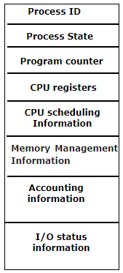
PCB (Continue …)
Program counter: indicates the address of the next instruction that has to be executed for that particular process.
CPU register : The registers that are being used by a particular process. There are different kinds of registers such as index registers, stack pointers, and general purpose registers etc.
Fig: PCB

Slide 18
PCB (Continue …)
CPU scheduling information: It has priority, scheduling queue pointers (to indicate the order of execution), and several other scheduling parameters.
Memory-management information: represents the memory that are being used by a particular process. It include information such as the value of the base and limit registers, the page tables, the segment tables etc.
I/O Status Information: This information includes the list of I/O device used by the process, and the list of files etc.

Slide 19
Threads
A thread is the subset of a process
Also known as the lightweight process.
A process can have more than one thread, and these threads are managed independently by the scheduler.
All the threads within one process are interrelated to each other.
Threads have some common information, such as data segment, code segment, files, etc. that is shared to their peer threads.
But it contains its own registers, stack, and counter.

Slide 20
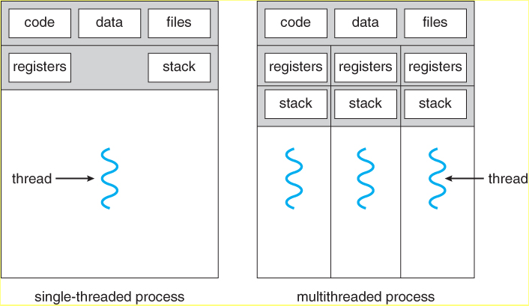
Threads (Continue…)
Fig - Single-threaded and multithreaded processes

Slide 21
Threads (Continue…)
Differences
Process | Threads
It is instance of a program that is being executed. Independent of each other and hence don't share a memory or other resources. Each process is treated as a new by the operating system. If one process gets blocked by the OS, then the other process can continue the execution. | It is a segment of a process or a lightweight process. Threads are interdependent and share memory. The OS takes all the user-level threads as a single process. If any user-level thread gets blocked, all of its peer threads also get blocked

Slide 22
Threads (Continue…)
Process | Threads
Context switching between two processes takes much time as they are heavy. The data and code segment of each process are independent of the other. OS takes more time to terminate a process. New process creation is more time taking as each new process takes all the resources. | Context switching between the threads is fast because they are very lightweight . Threads share data and code segment with their peer threads; Threads can be terminated in very little time. A thread needs less time for creation.

Slide 23
Threads
Advantages
  Minimize the context switching time.
  Provides concurrency within a process.
  Efficient communication.
  Allow utilization of multiprocessor architectures to a greater scale and efficiency.

Slide 24
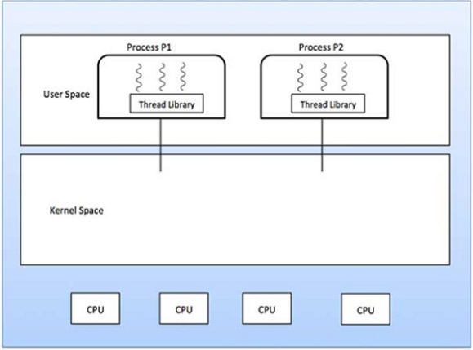
Types of Thread
User Level Threads

Slide 25
Types of Thread (continue …)
User Level Threads (Continue…)
  Managed by users.
  Kernel is not aware of the existence of threads.
  Multithreading is not compatible
  The thread library contains code for creating and destroying threads.
  Doesn’t recognized by OS .
  Take less time for context switching.
  Can be created and managed quickly.
  Example: Java thread

Slide 26
Types of Thread (Continue . . .)
Advantages
  Simple and quick to create.
  Can run on any operating system
  They don’t need system calls to create threads.
  Switching between threads does not need kernel mode privileges.
  If a thread in the kernel is blocked, it does not block all other threads in the same process.
Disadvantages
  Cannot benefit from multiprocessing.
  If a thread performs a blocking operation, the entire process is halted.

Slide 27
Types of Thread (Continue . . .)
Kernel level threads (Continue . . .)
  Managed by OS.
  Multithreading is compatible
  Complicated implementation.
  Take more time to context switching
  Hardware support is needed.
  If one kernel thread performs a blocking operation then another thread can continue execution.
  If a thread in the kernel is blocked, it does not block all other threads in the same process.

Slide 28
Multithreading
Multithreading refers to the ability of an OS to support multiple threads of execution within a single process.
If a process has multiple thread of control, it can perform more than one task at a time
Each threads have their own program counter, stacks and registers; But they share common code, data and some OS data structures like files.

Slide 29
Thread Models
Mapping of user level threads to kernel level threads.
The user threads maps to kernel threads in one of the following strategies:
  One to one model
  Many to one model
  Many to Many models

Slide 30
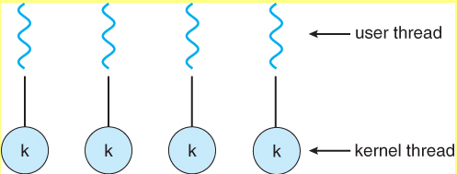
Thread Models (continue …)
One to one model
  Maps a single user to a single kernel-level thread.
Fig: One to one thread model

Slide 31
Thread Models (continue …)
  Allows multiple threads to run in parallel on multiprocessors
  Drawbacks: The generation of every new user threads must include creating a corresponding kernel threads causing an overhead.
Many to one
  Maps many user levels threads to one kernel thread.
  Thread management is handled by the thread library in user space, which is very efficient.
  Facilitates an effective context-switching environment.
  Disadvantage:
    If a blocking system call is made, then the entire process blocks.

Slide 32
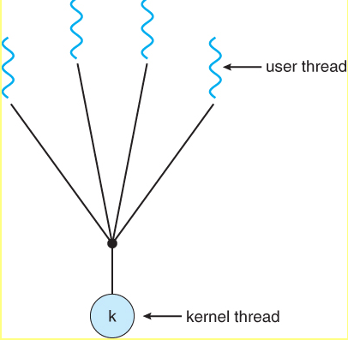
Thread Models (continue …)
    Since only one thread can access a kernel at a time, multiple threads are unable to in parallel on multiprocessors
Fig : Many-to-one model

Slide 33
Thread Models (continue …)
Many to many model
  Multiplexes any number of user threads onto an equal or smaller number of kernel threads.
  Combining the best features of the one-to-one and many-to-one models.
  Users can create any number of threads.
  When a thread performs, a blocking system call, the kernel can schedule another thread for execution.
  Processes can be split across multiple processors.

Slide 34
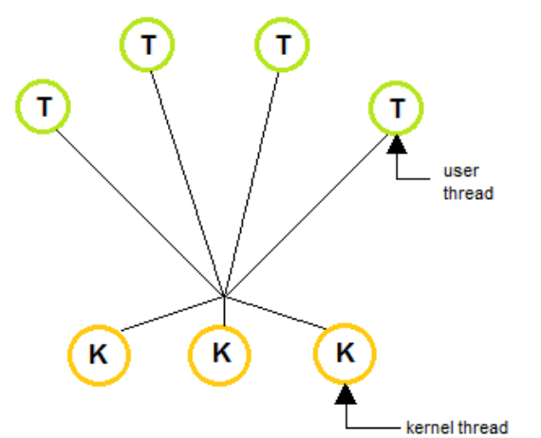
Thread Models (continue …)
Fig: Many to many model

Slide 35
Inter process communication (IPC)
Processes frequently need to communicate with other processes.
IPC is the way in which process communicate with each other.
The process concurrently executing in OS either Independent or Cooperating process.
  Independent process: The execution of one process does not affect the execution of another process.
  Cooperating process: The execution of one process affects the execution of another process.

Slide 36
IPC (continue…)
  These processes need to be synchronized so that the order of execution can be guaranteed.
Reasons for cooperation
  Information sharing: for example several users interested to access files concurrently.
  Computation speedup: to computational speed up divide the task into several subtasks. All those subtasks made to run simultaneously by assigning several different processors.

Slide 37
IPC (continue…)
  Modularity: Dividing the system in to different modules and later modules put together to achieve the single goal. Those modules should communicate or cooperate to each other.
  Convenience: While running different tasks at the same time, should be run smoothly without crash each other.

Slide 38
IPC (continue…)
There are two fundamental models of IPC
  Shared memory: The region of memory shared by cooperating processes. Processes can exchange information by writing and reading to and from the shared region.
  Message passing: Communication takes place by means of exchange messages between the cooperating processes.
    This is particularly useful for distributed environment, where the communicating process reside different computers connected by a network.

Slide 39
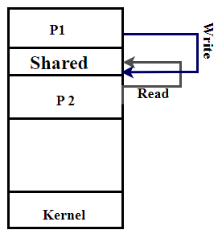
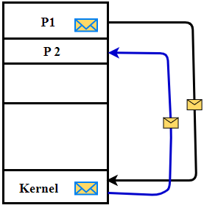
IPC (continue…)
Fig: b Message passing
  Fig: a Shared memory

Slide 40
Race condition
A race condition is a situation that may occur inside a critical section.
This happens when the result of multiple thread execution in critical section deviate according to the order in which the threads execute.
Proper thread synchronization variables can prevent race conditions.
This leads to data inconsistency
The figure in the next slide shows how race condition can occur.

Slide 41
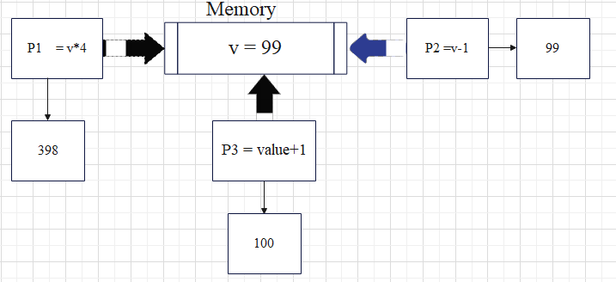
Race condition (Continue . . .)
Fig: Race condition

Slide 42
Critical Section (CS)
In multiprogramming, to avoid erroneous behavior the shared resource need to be protected.
The protected section is critical section.
It can’t be executed more than one process at a time.
the entry sections handles the entry into the critical section. It acquires the resources needed for execution by the process.
The exit section handles the exit from the critical section. It releases the resources and also informs the other processes that critical section is free.
The critical section problem needs a solution to synchronize the different processes.

Slide 43
Critical Section (Continue…)
The solution to the critical section problem must satisfy the following conditions:
  Mutual Exclusion: This implies that only one process can be inside the critical section at any time. If any other processes require the critical section, they must wait until it is free.
  Progress : means that if a process is not using the critical section, then it should not stop any other process from accessing it. In other words, any process can enter a critical section if it is free.
  Bounded Waiting: Means that each process must have a limited waiting time. It should not wait endlessly to access the critical section.

